Slide 1
DATS6401: Final Project
Time Series Forecasting Using SageMaker Canvas
Team : 4
Remya Sulabha
Likhitha Kempegowda
Shikha Kumari

Slide 2
Table of contents
01
02
03
04
05
06
Scope
Features
Data Sources
Architecture
Data Flow
Outcome

Slide 3
01
Scope

Slide 4
Scope
Objective: To predict future stock prices based on historical data using Sagemaker for the next 30 days.
Target Audience: Investors, analysts, and traders looking for automated predictions to assist in making informed decisions.
Core Functionality: Develop a pipeline that ingests historical stock price data, trains a forecasting model, and visualizes the future trends.

Slide 5
02
Features

Slide 6
Features
Stock Price Forecasting: Using AWS Sagemaker to generate predictions of future stock prices based on historical data trends.
Data Storage and Management: Store historical stock data in Amazon S3 for training and future predictions.
Visualization Dashboards: Use Amazon QuickSight to create real-time dashboards for stock price predictions and trend analysis.

Slide 7
03
Data Sources

Slide 8
Data Sources
Dataset Description: Historical stock price data from the Yahoo API, which includes stock prices for companies like Apple, Google, and others.
Key Variables:
Date, Open, High, Low, Close, Volume, Brand Name, Ticker, Country.
Source: This dataset is extracted from Yahoo Finance API.

Slide 9
04
Architecture and Data Flow

Slide 10





Architecture: Showing the Flow of Data
Amazon SageMaker

Slide 11
05
Implementation

Slide 12
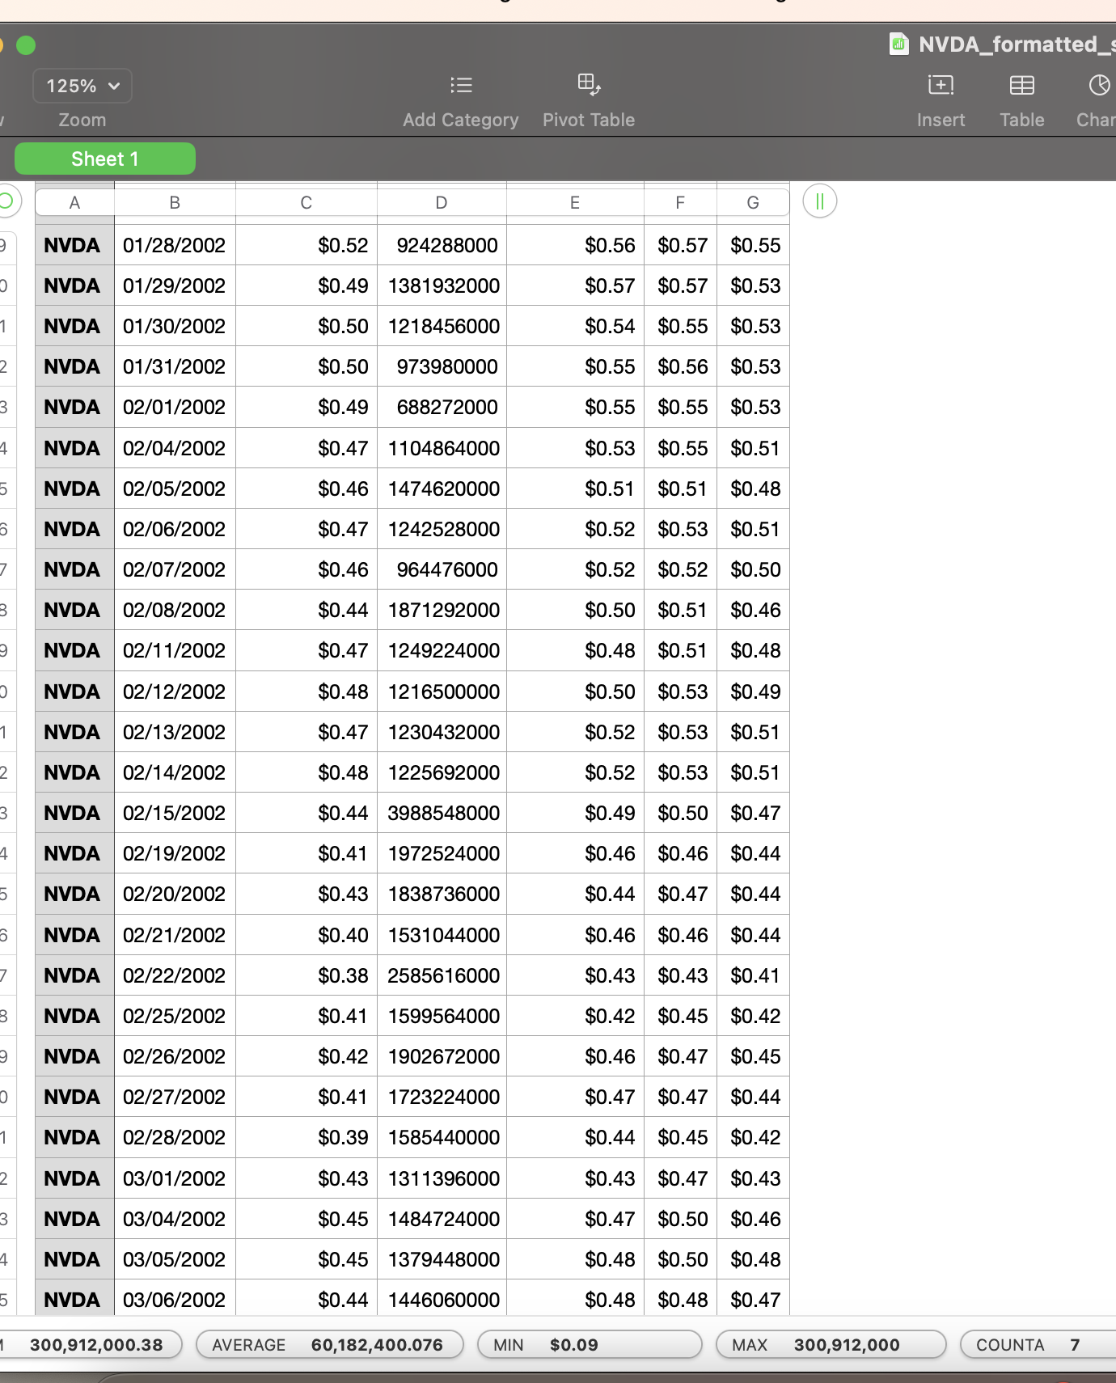
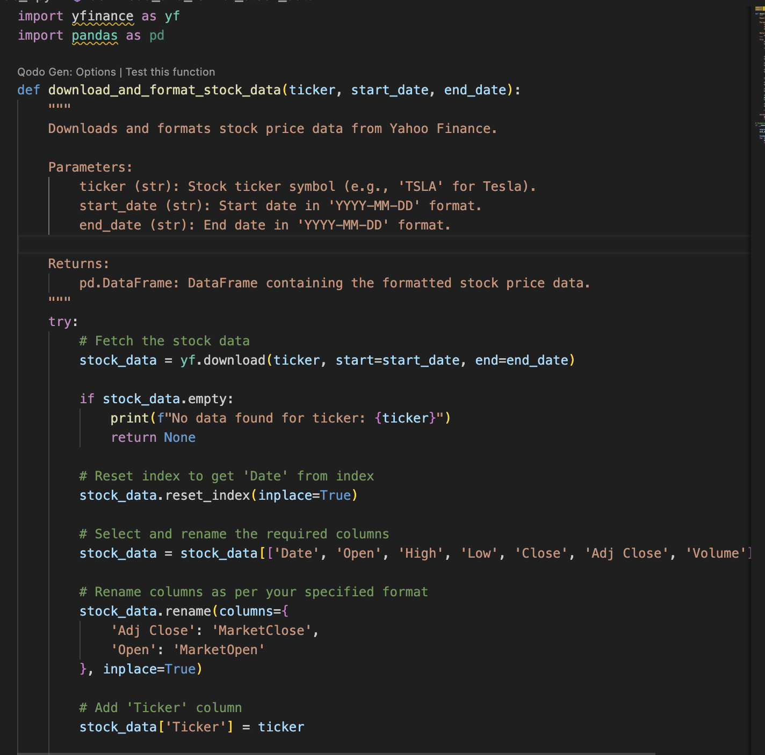
Step 1: Download Data From Yfinance

Slide 13
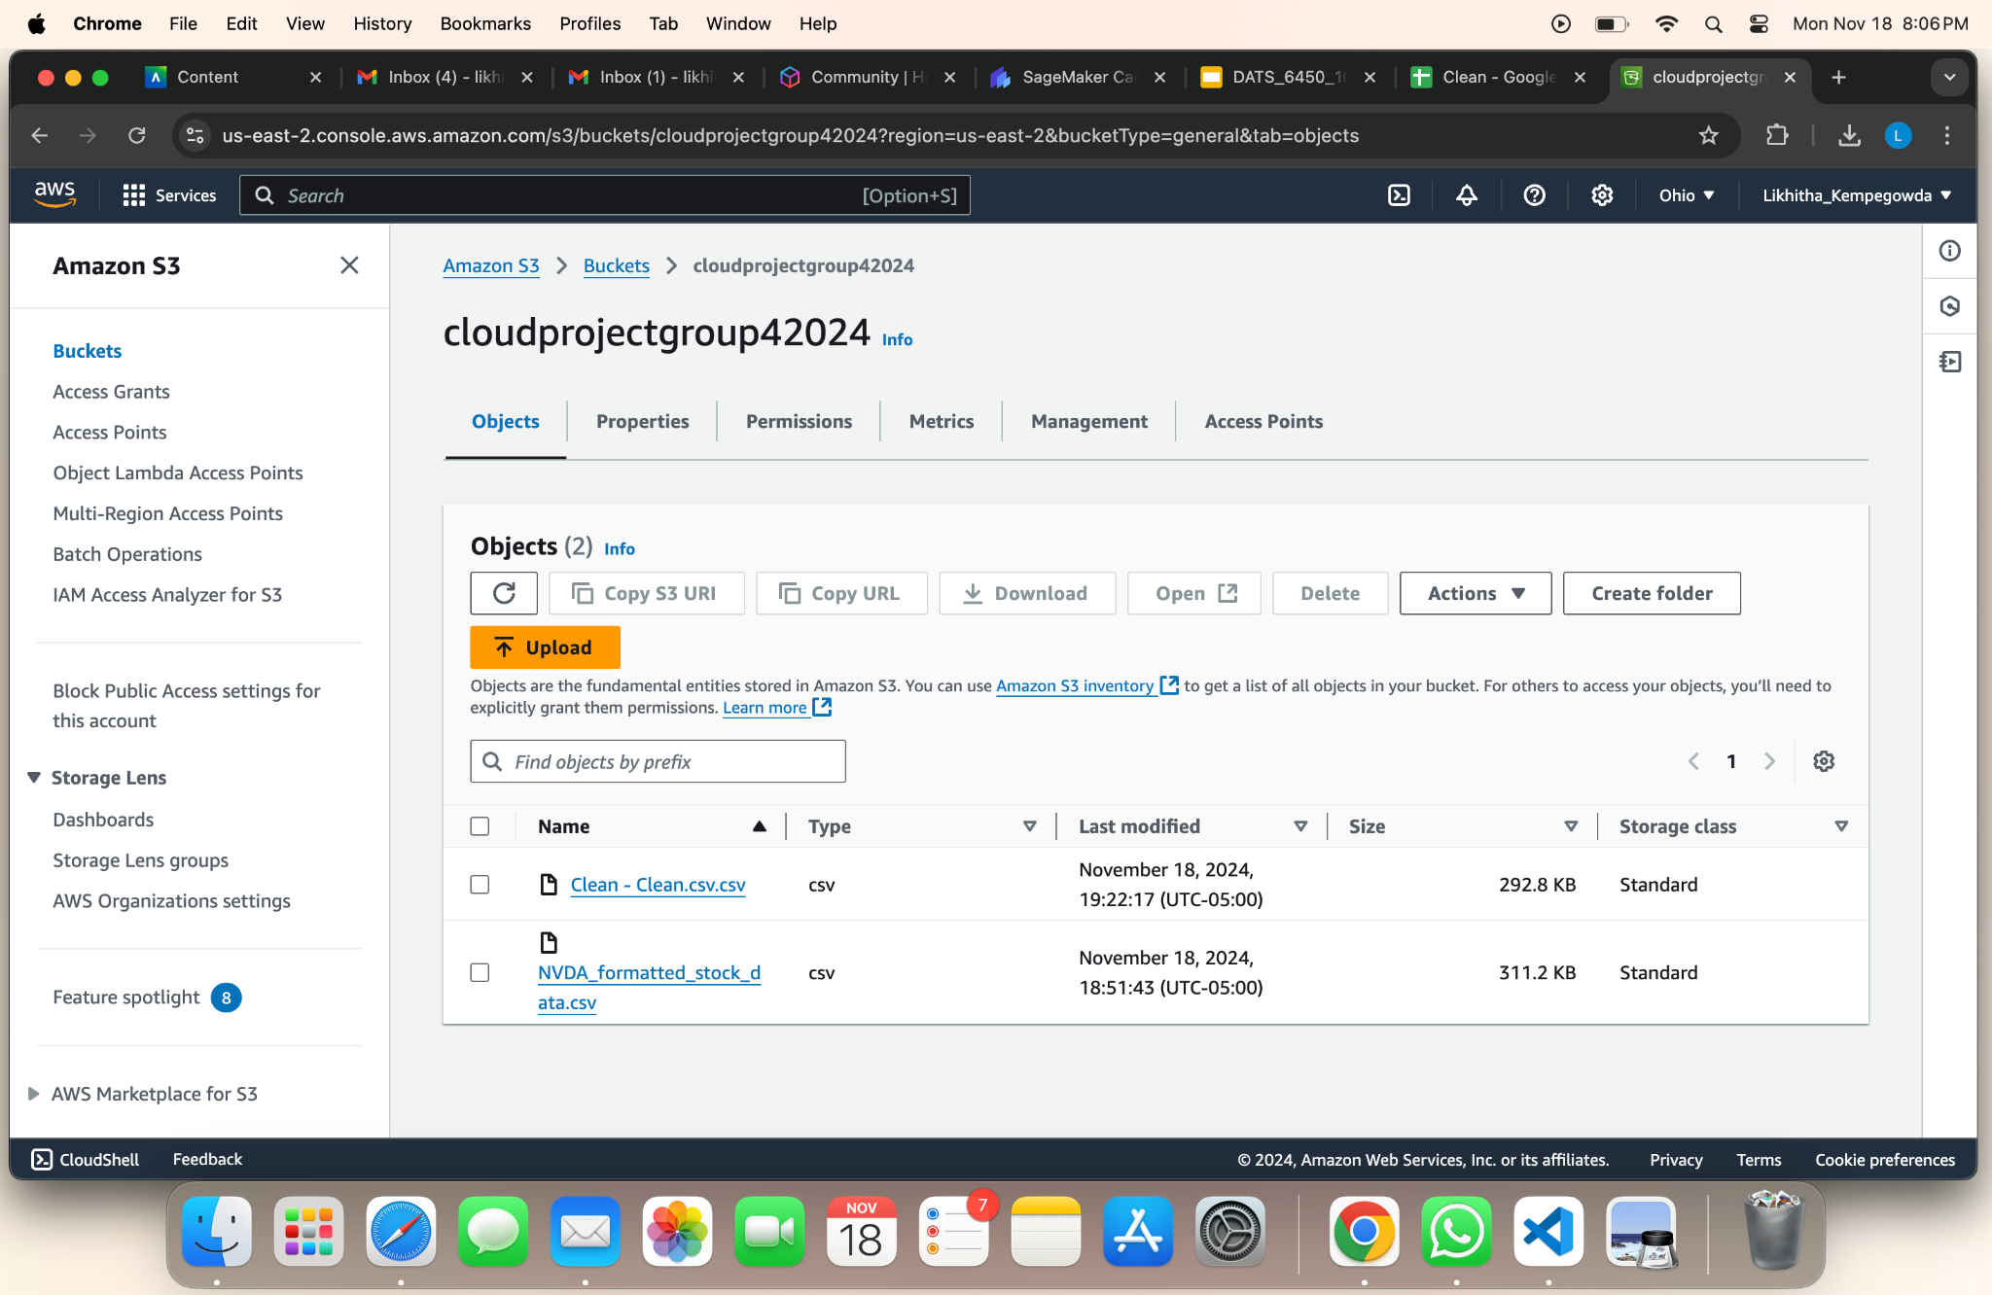
Step 2: Clean The Data Using Aws Glue And Load It Into S3

Slide 14
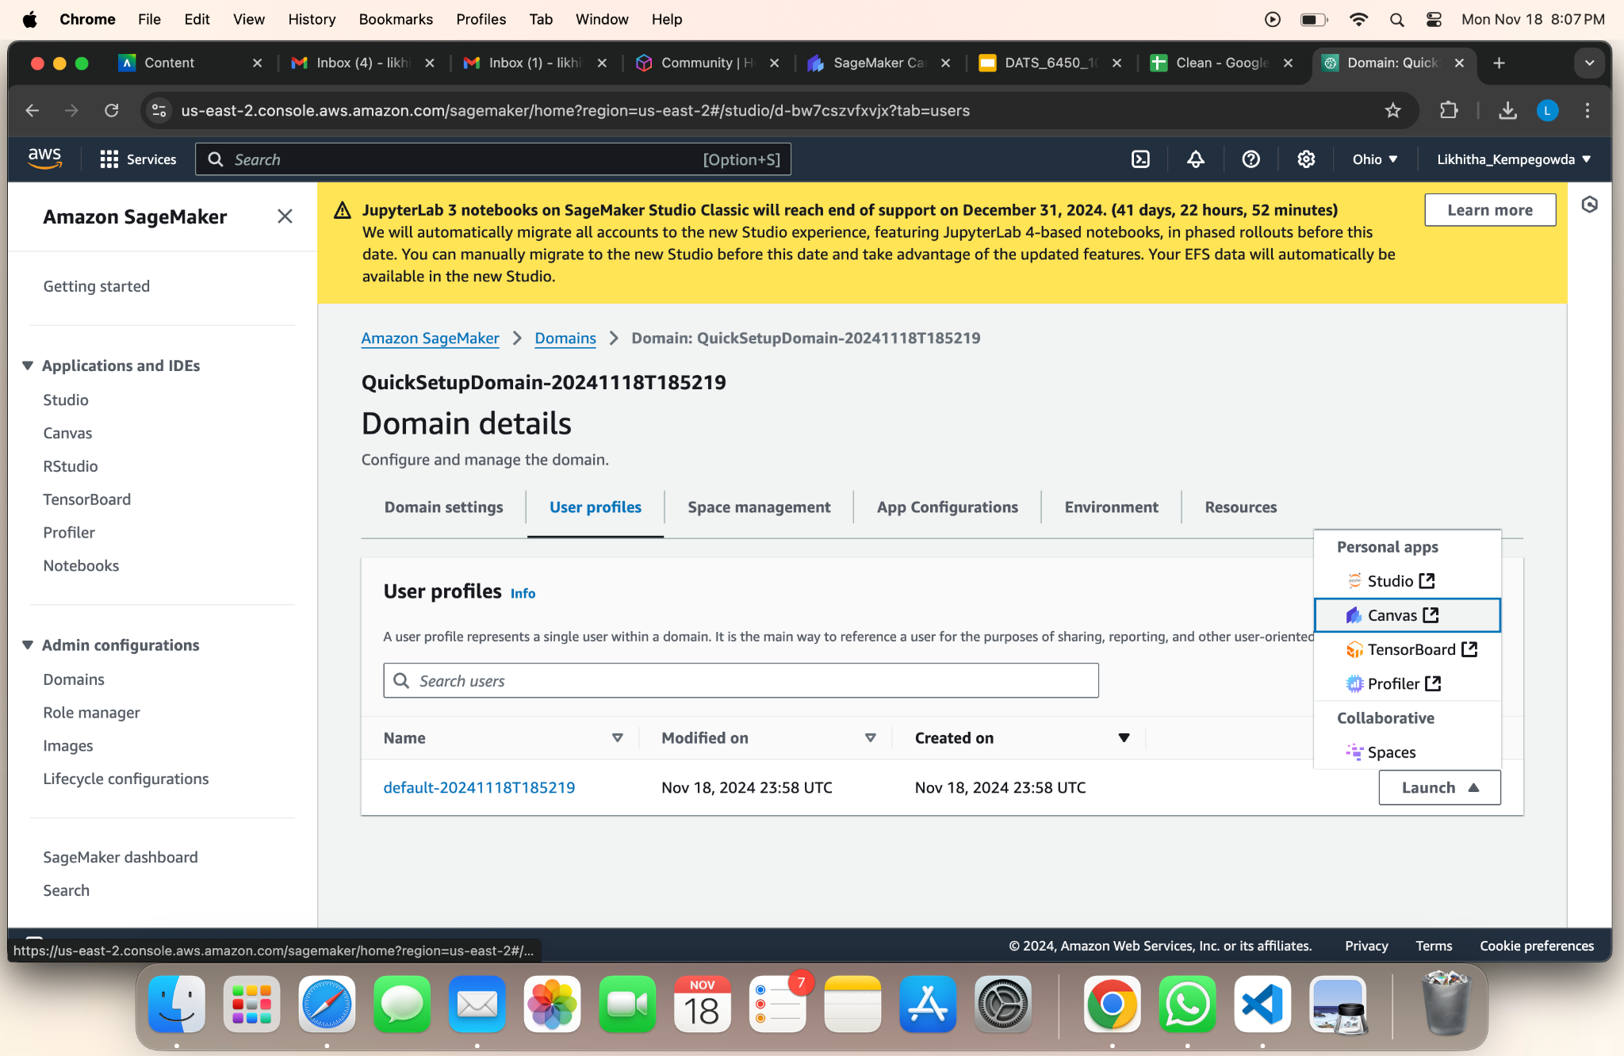
Step 3: Launch Sagemaker

Slide 15
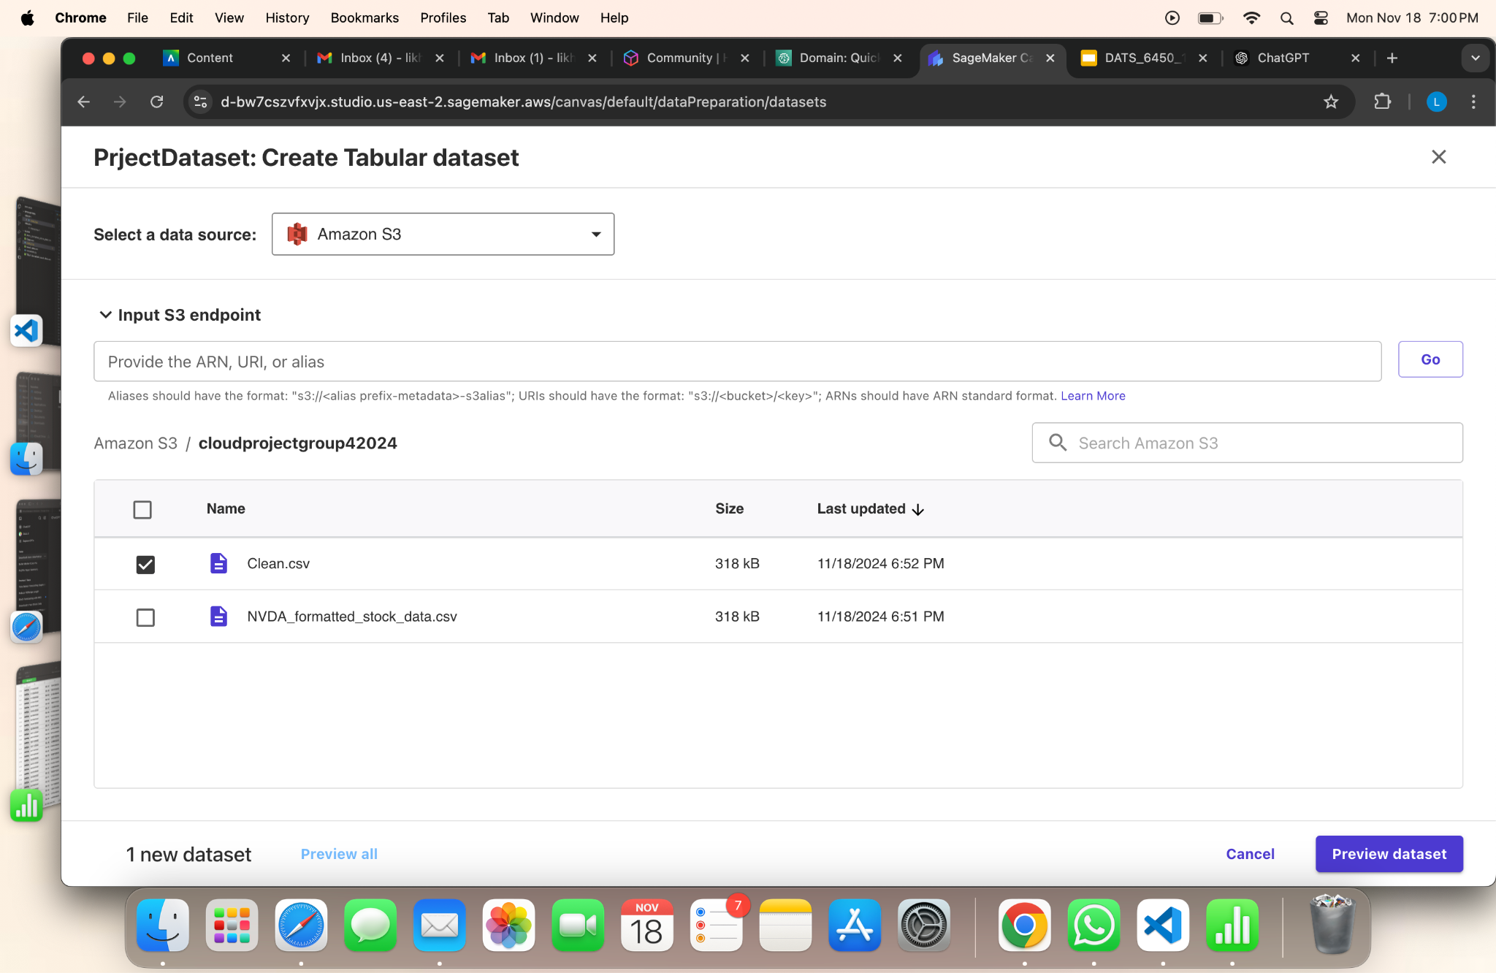
Step 4: Create Model And Make Predictions

Slide 16
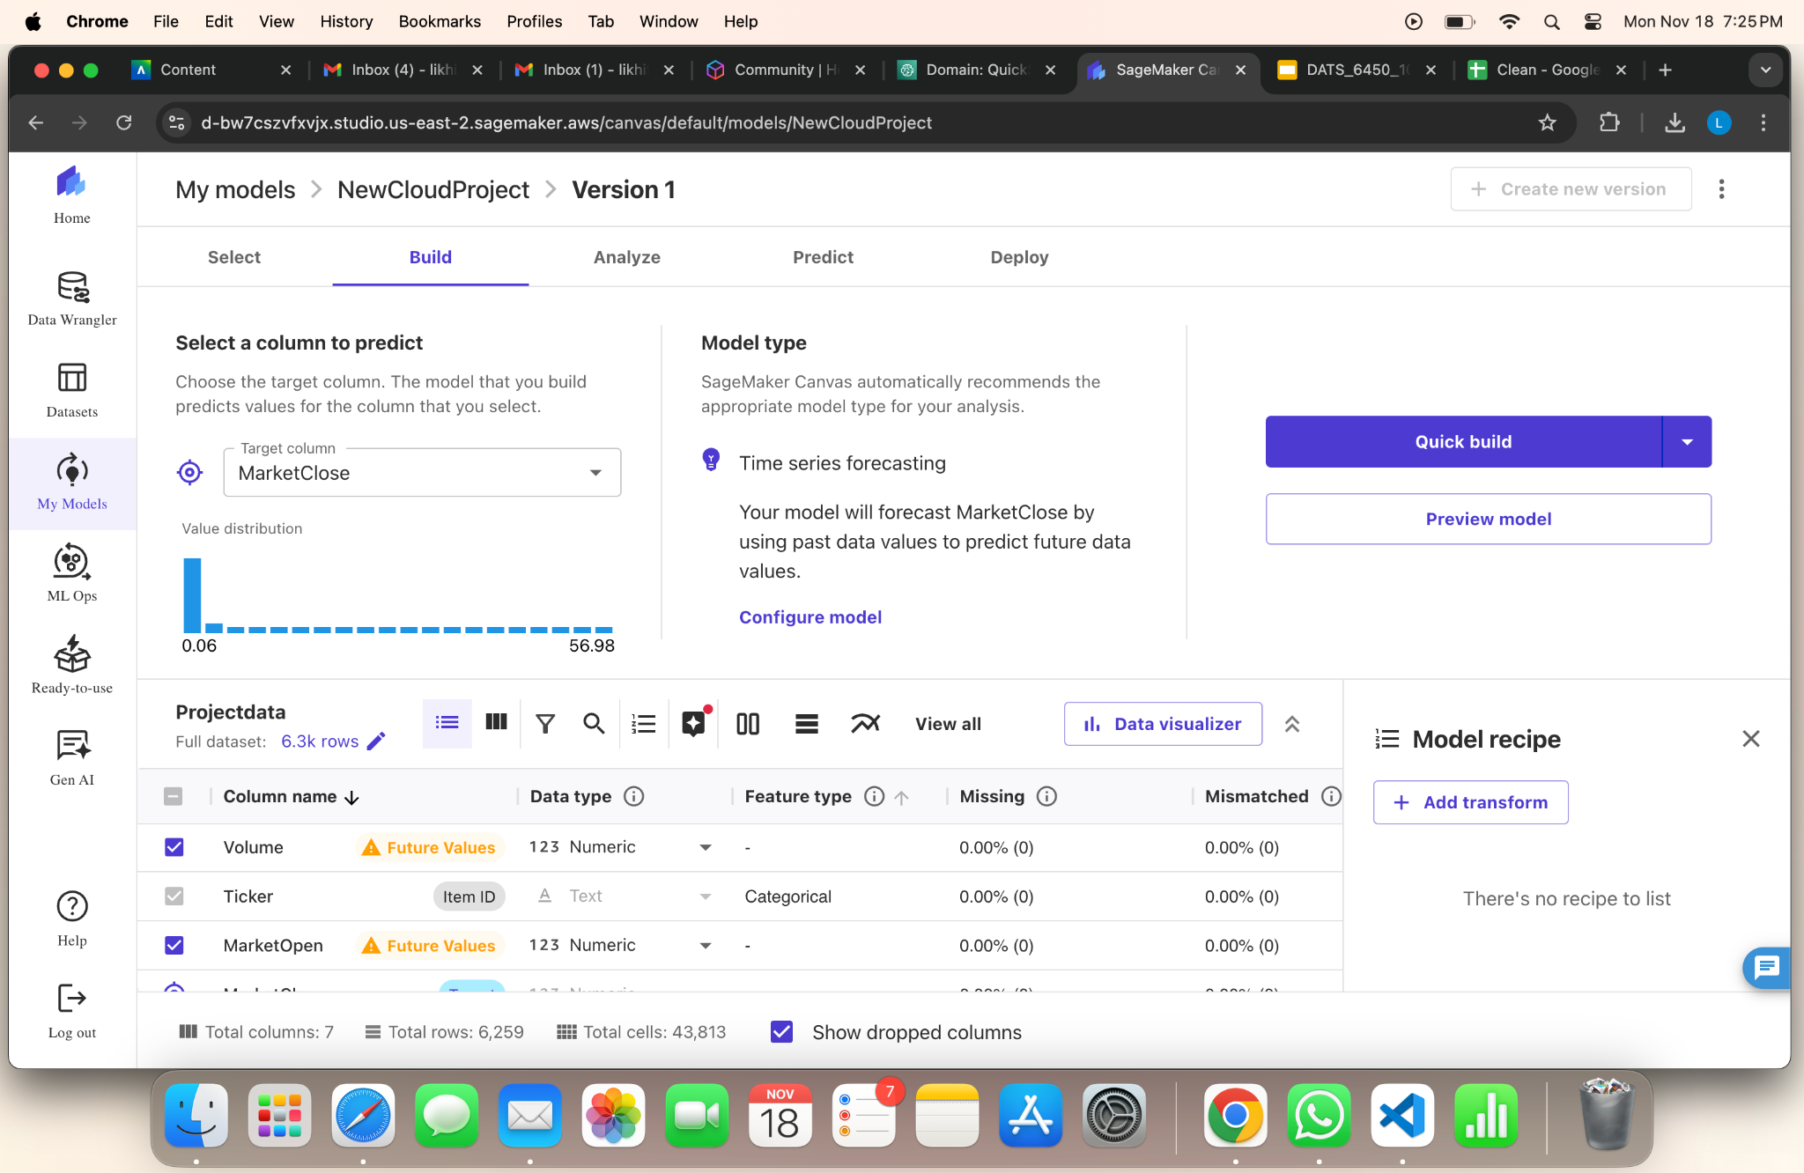
Step 4: Create Model And Make Predictions

Slide 17
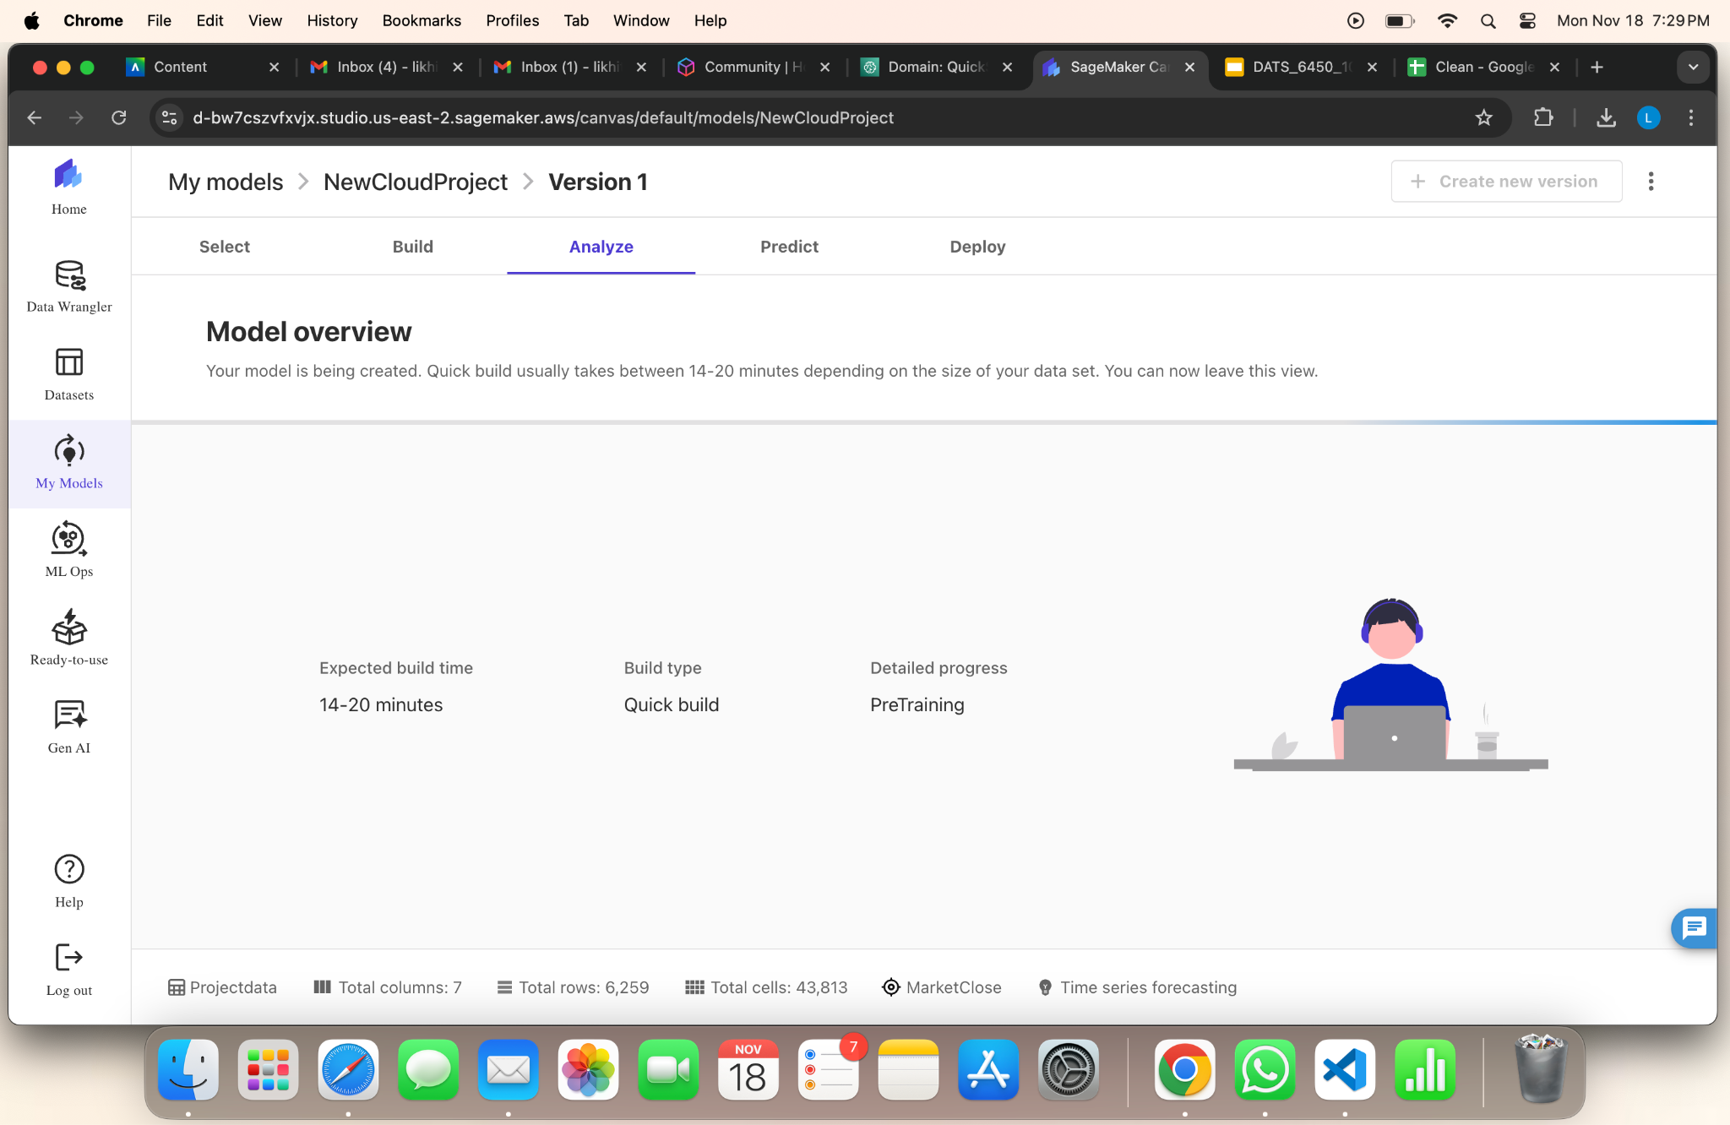
Step 4: Create Model And Make Predictions

Slide 18
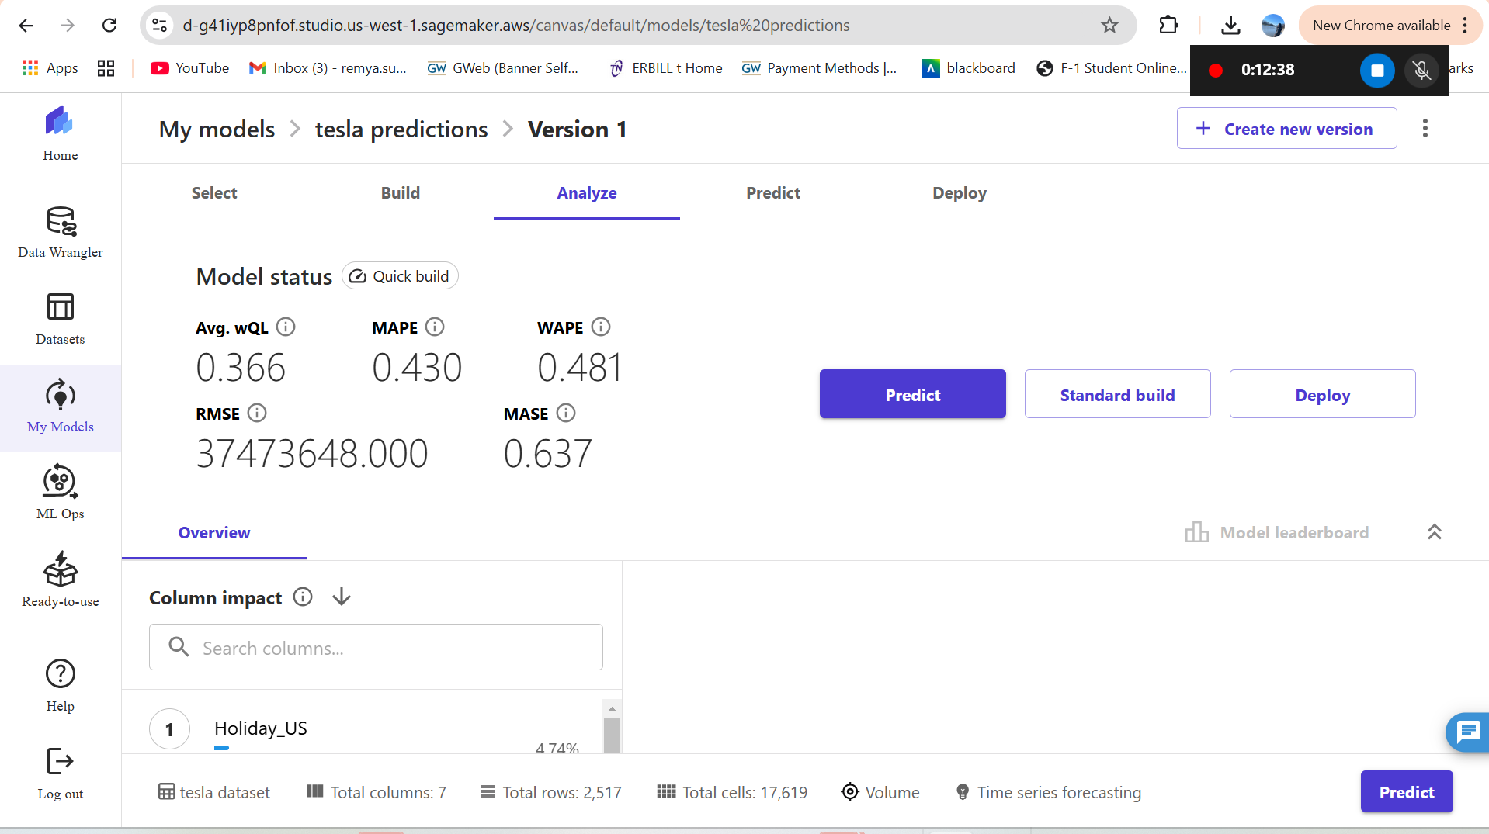
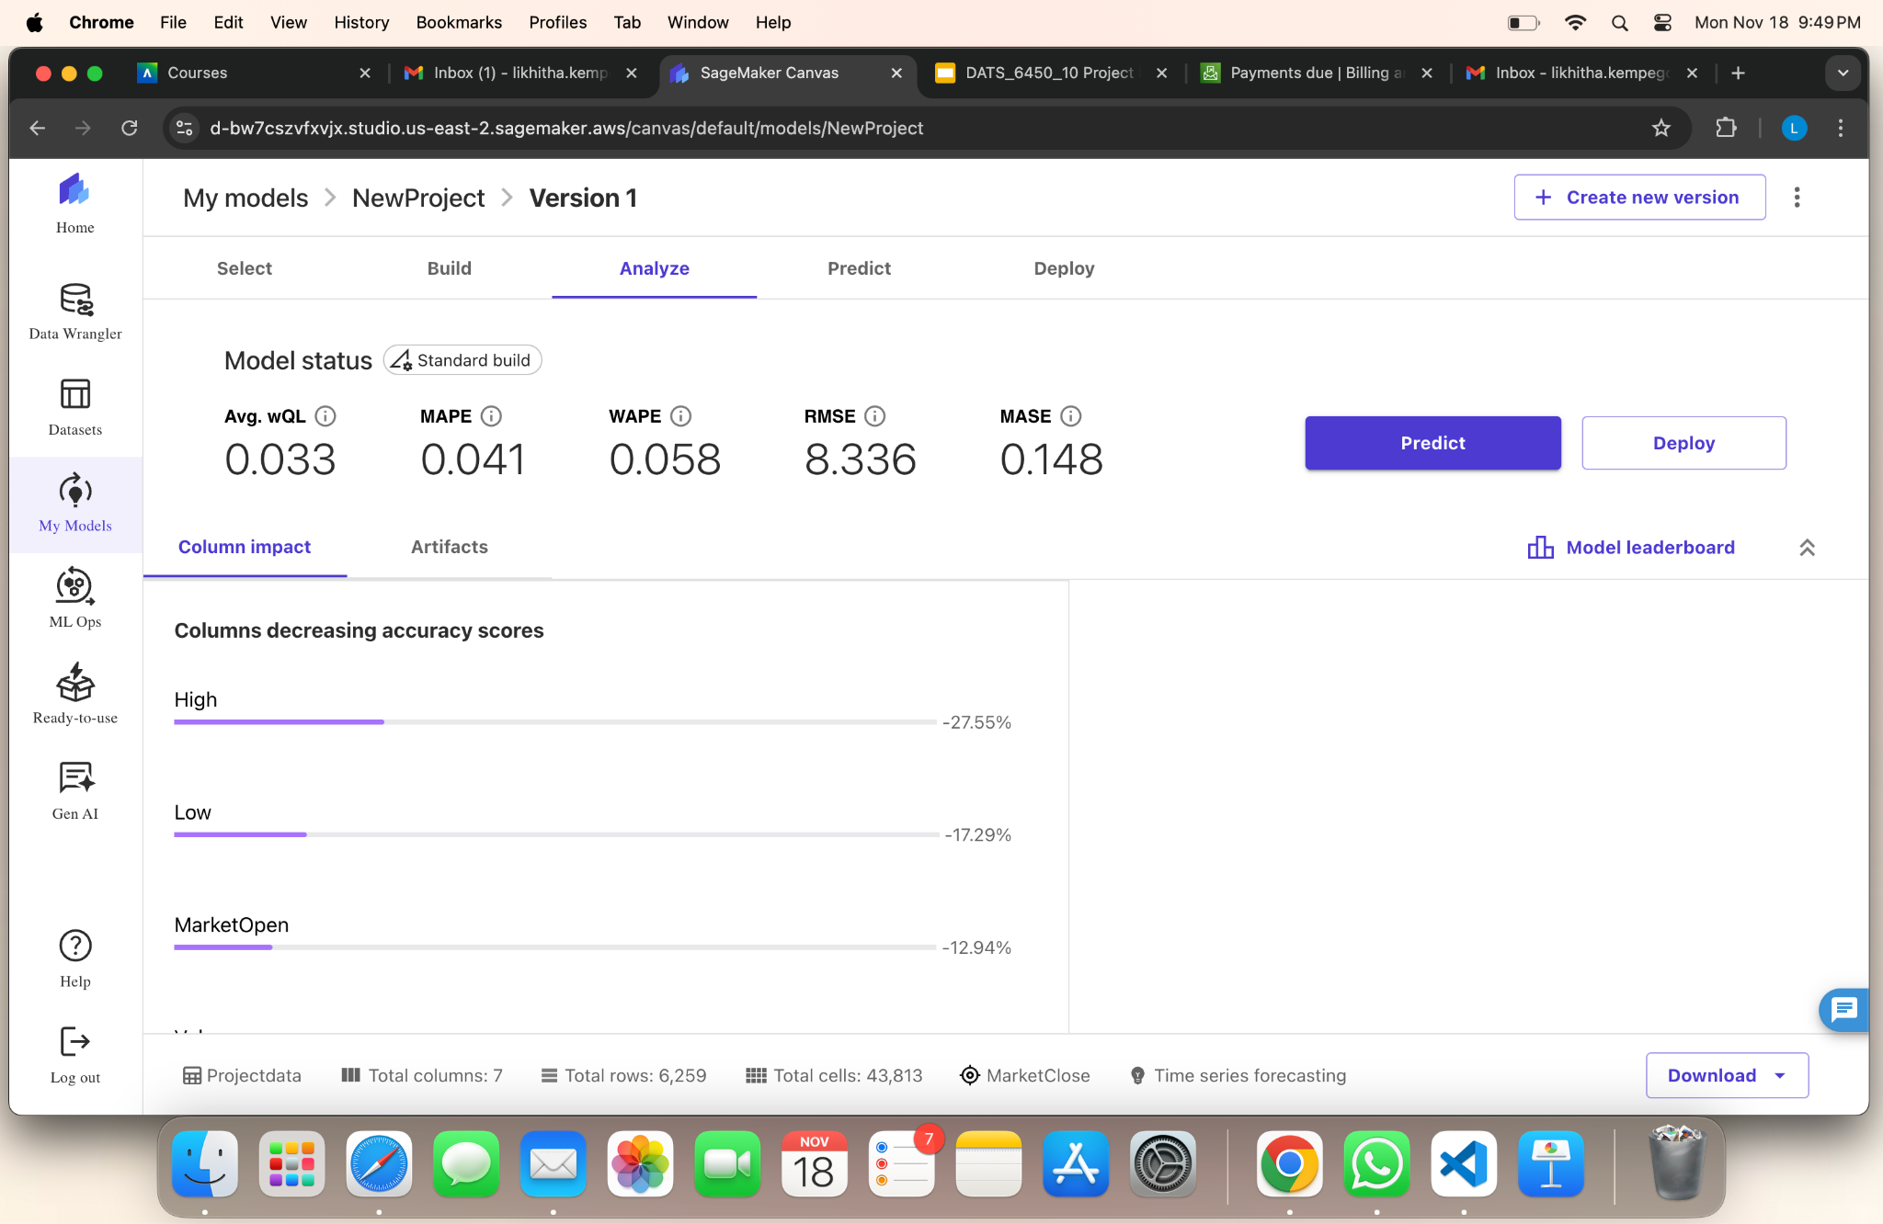
Step 4: Create Model And Make Predictions
TESLA
NVIDIA

Slide 19
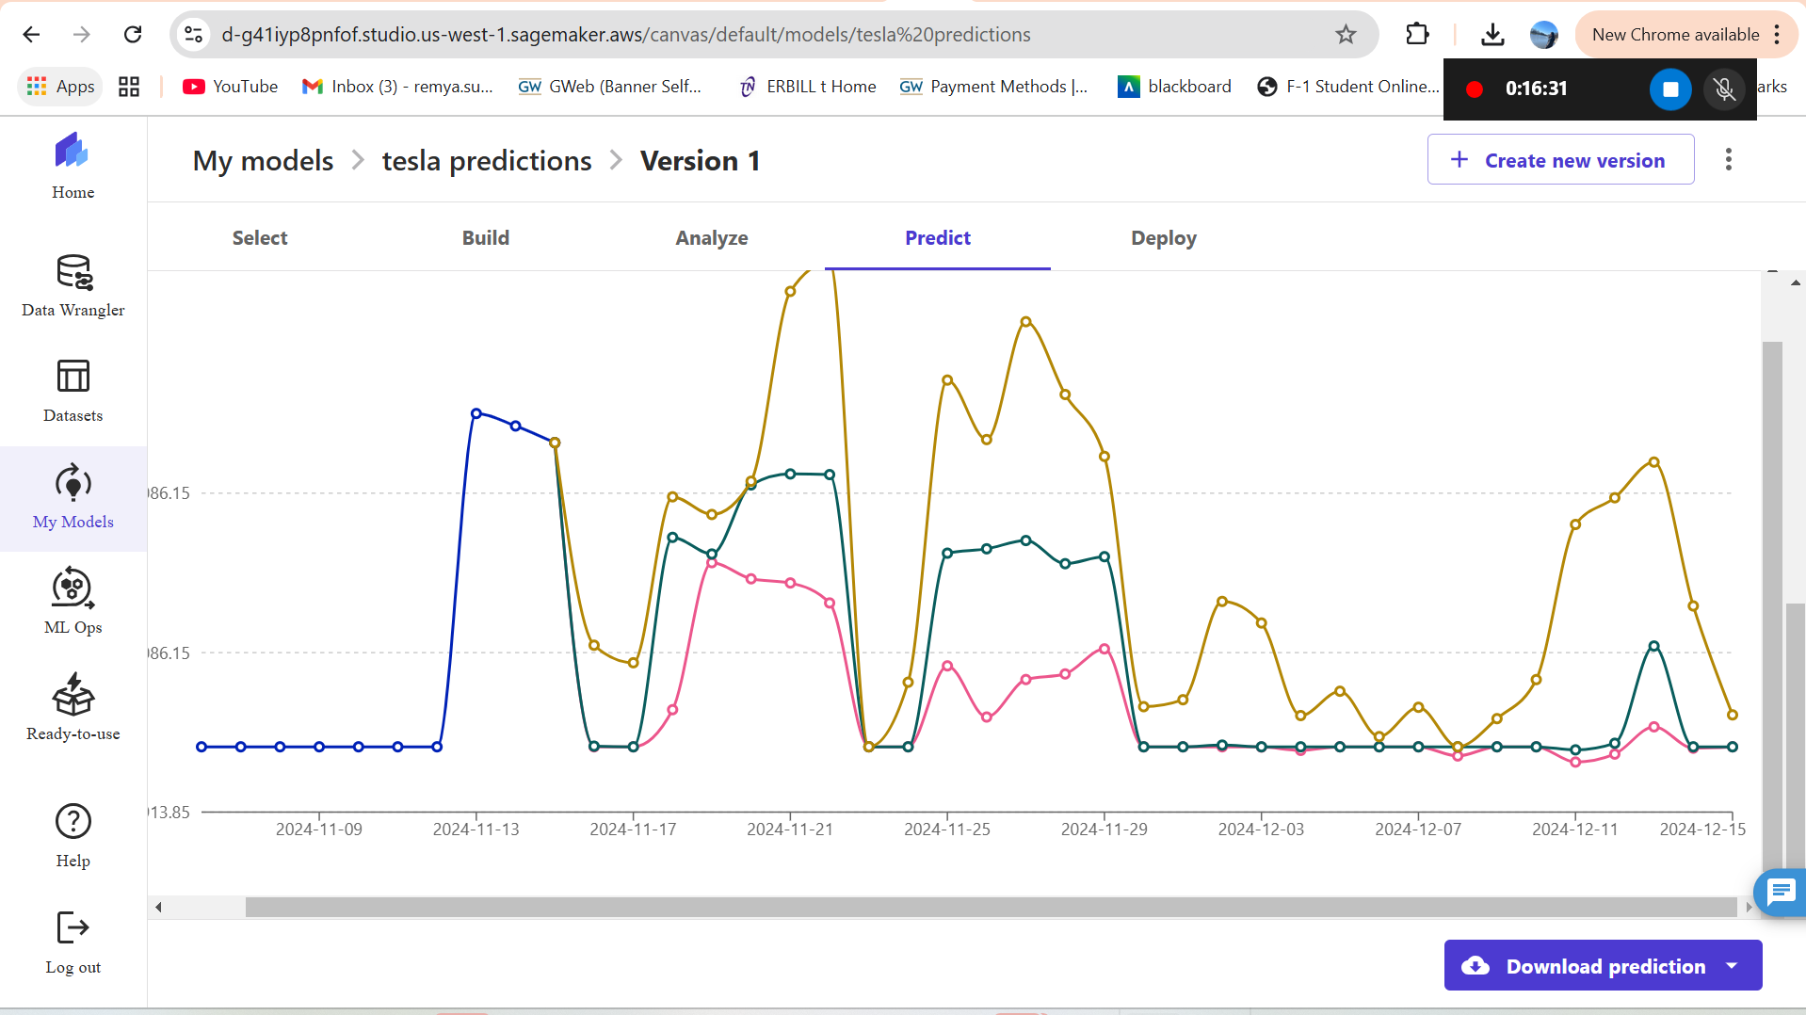
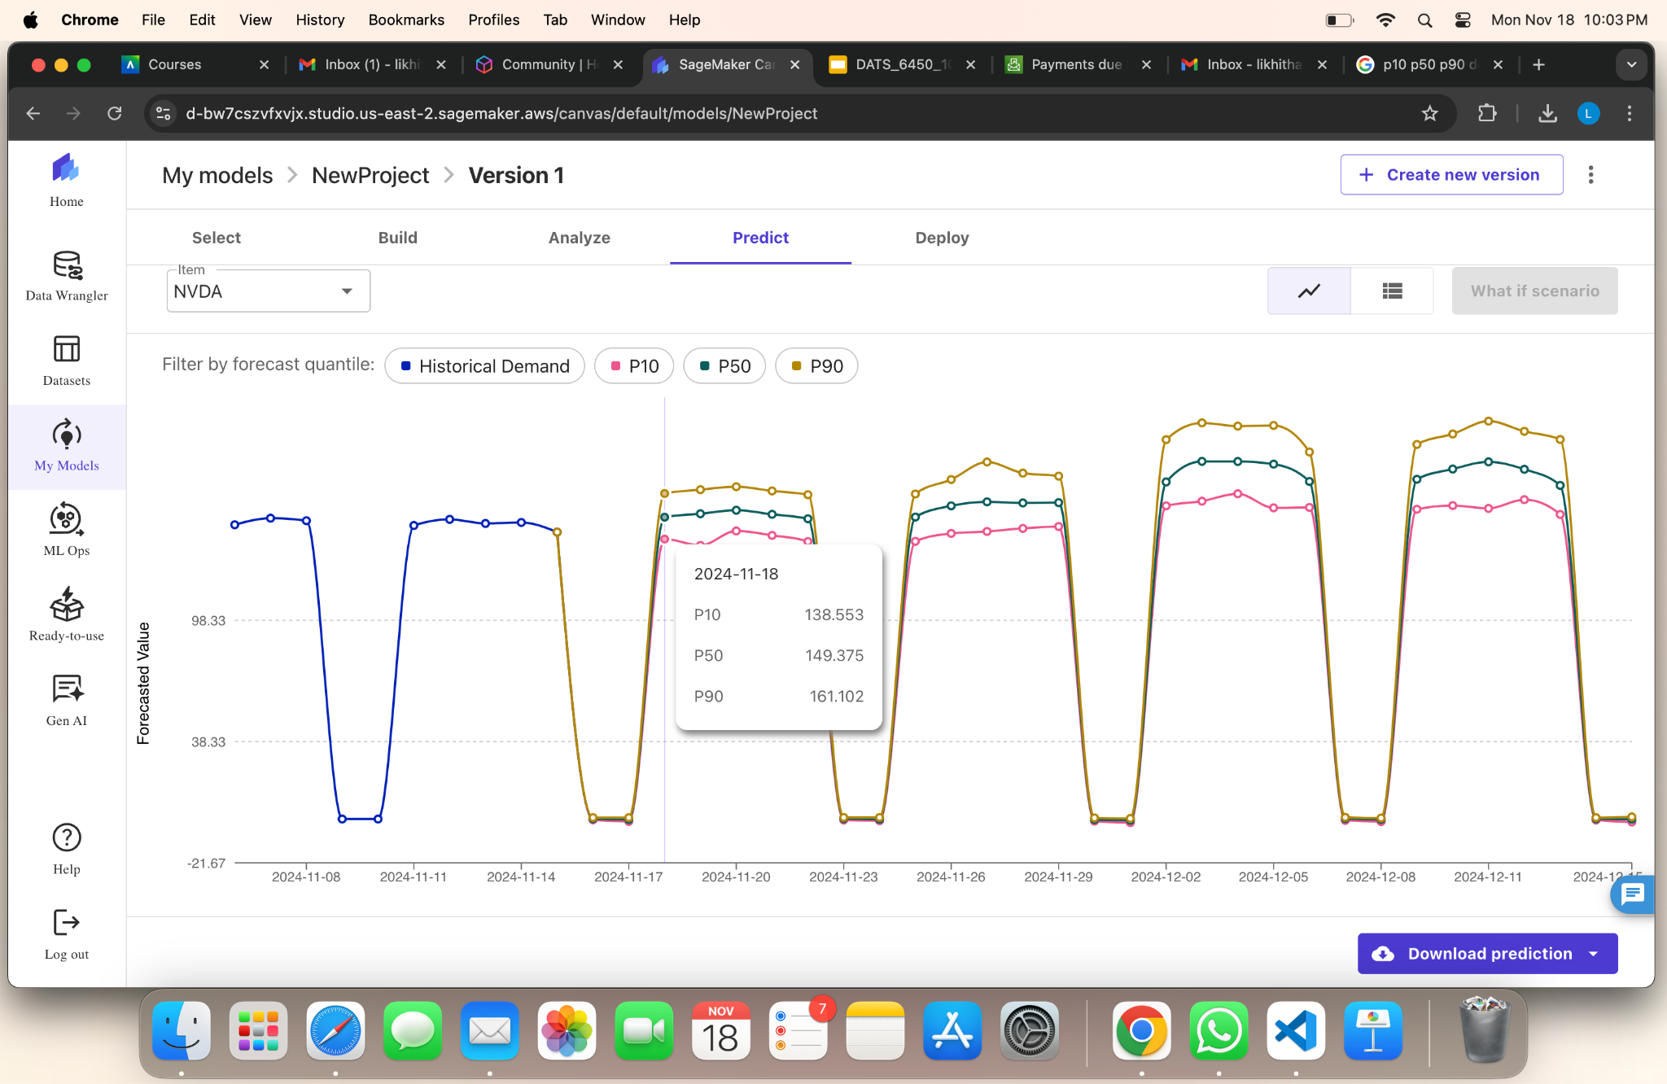
Step 4: Create Model And Make Predictions
TESLA
NVIDIA

Slide 20
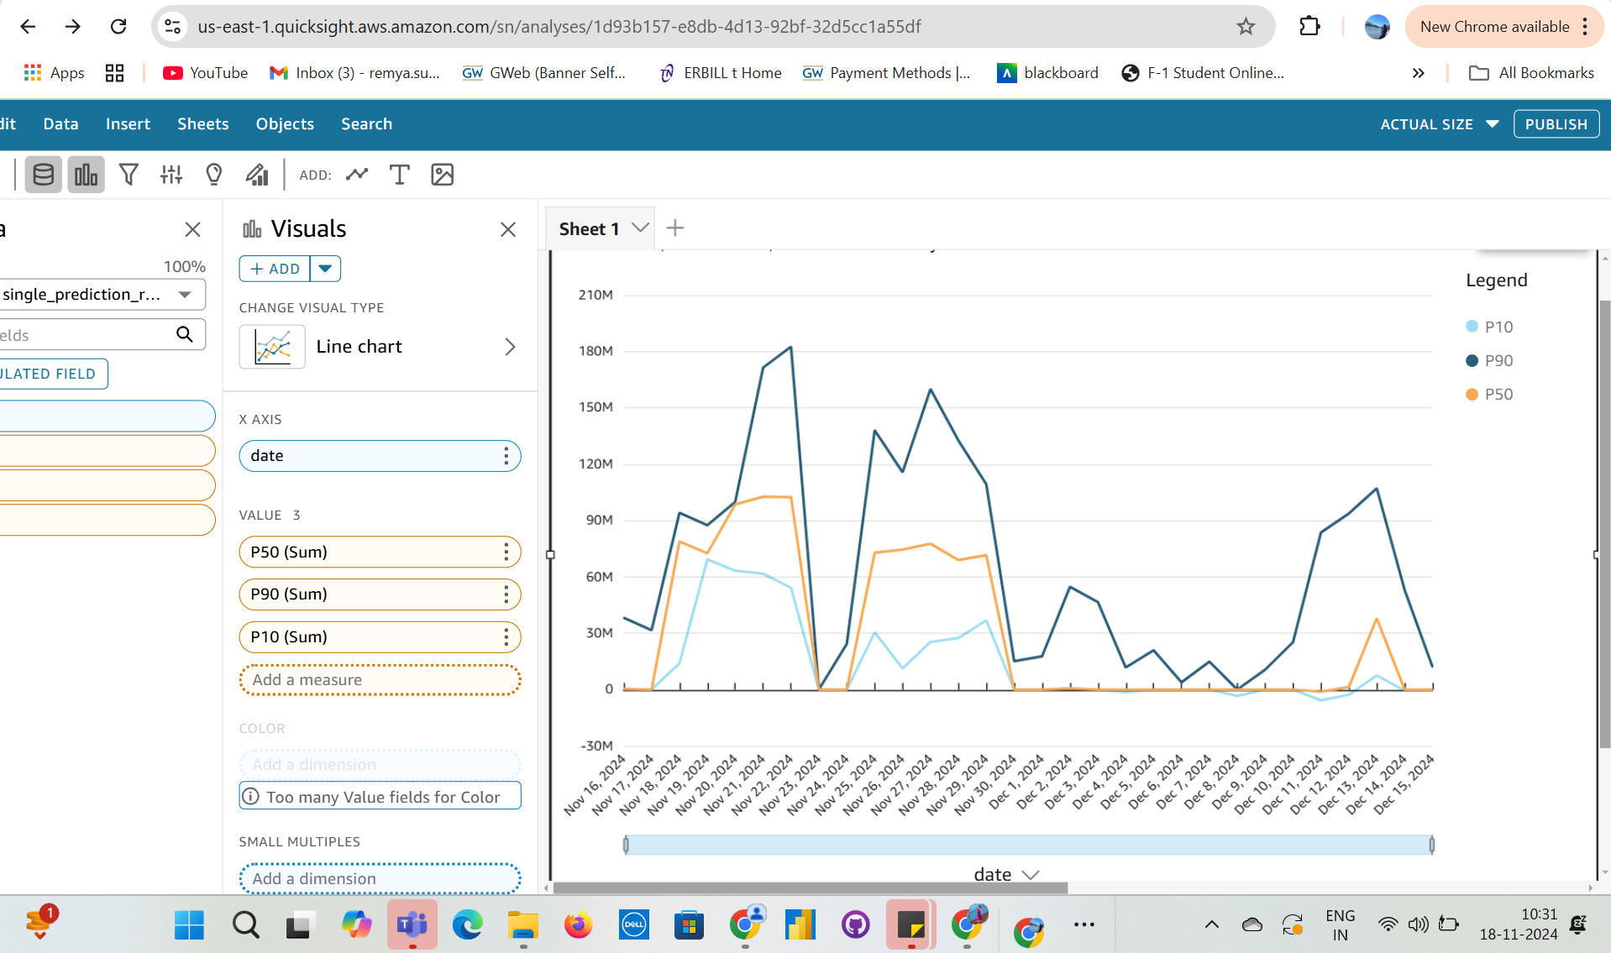
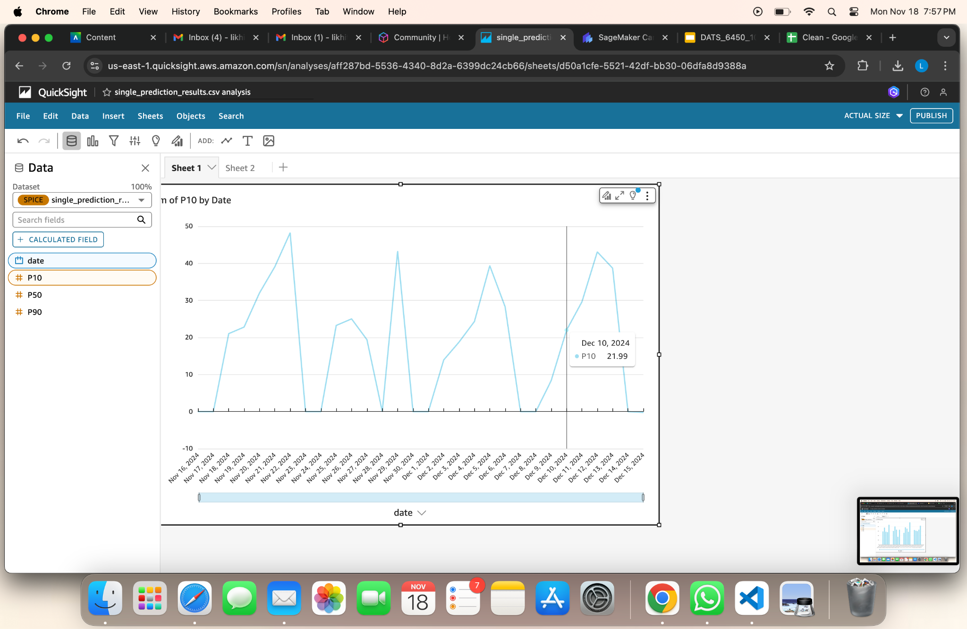
Step 5: Visualize Using Quicksight

Slide 21
05
Result

Slide 22
Results
Predicted the future Close price for selected companies based on historical trends.
Presented forecasted stock trends via Amazon QuickSight to enable users to interactively explore future predictions.
These results provide data-driven insights for potential stock movements, which can aid in investment decisions.

